Slide 1
Everything you wanted to know about writing async, high-concurrency HTTP applications in Java, but were afraid to ask

Slide 2

Agenda
Mostly this:
Notes:
Things that are not simple

Slide 3

Agenda
And this:
Notes:
Why you dont’s

Slide 4

Agenda
And this:
Notes:
Just avoid

Slide 5

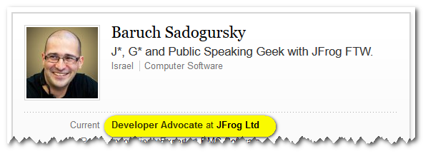
About your speaker
@jbaruch
github.com/jbaruch
linkd.in/jbaruch
stackoverflow.com/users/402053/jbaruch
Notes:
CURRENT – JB NEXT - YOAV

Slide 6
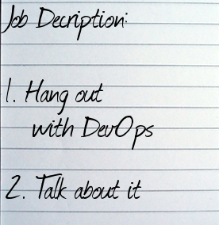
Developer who?

Slide 7

Developer who?

Slide 8

What Frog?

Slide 9
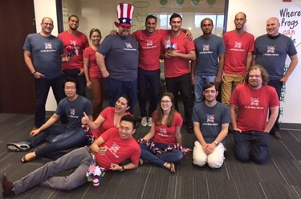
What Frog?

Slide 10

What Frog?

Slide 11

What Frog?

Slide 12


Slide 13


Slide 14


Slide 15

We serve binaries for a living

Slide 16

Concurrent downloads
Y U NO support them?!

Slide 17

Requirements
parallel file Downloads
Parallel file parts
interrupt/pause/resume
Progress events
Checksums caching

Slide 18
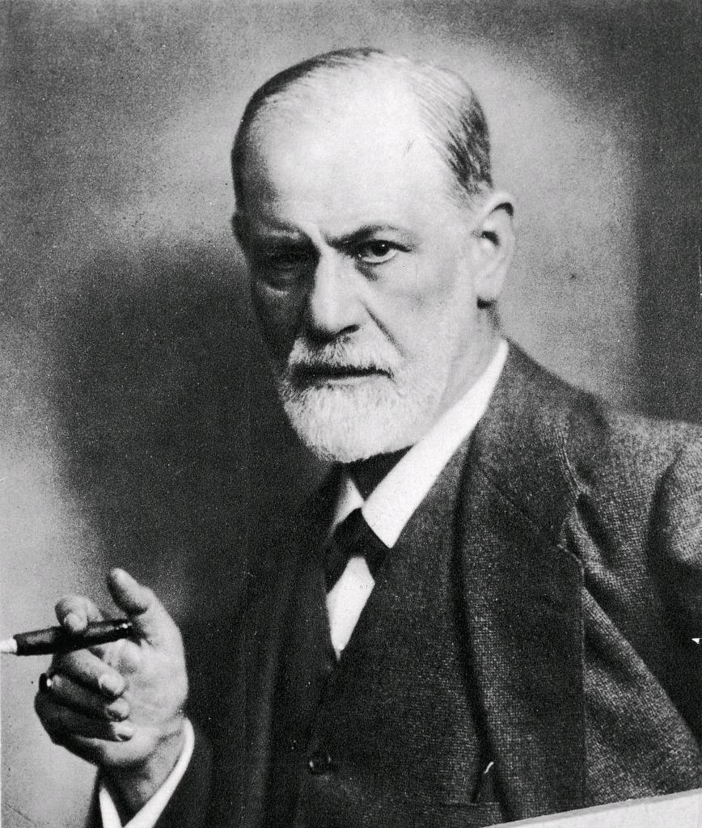
First Association for “concurrent downloader”

Slide 19
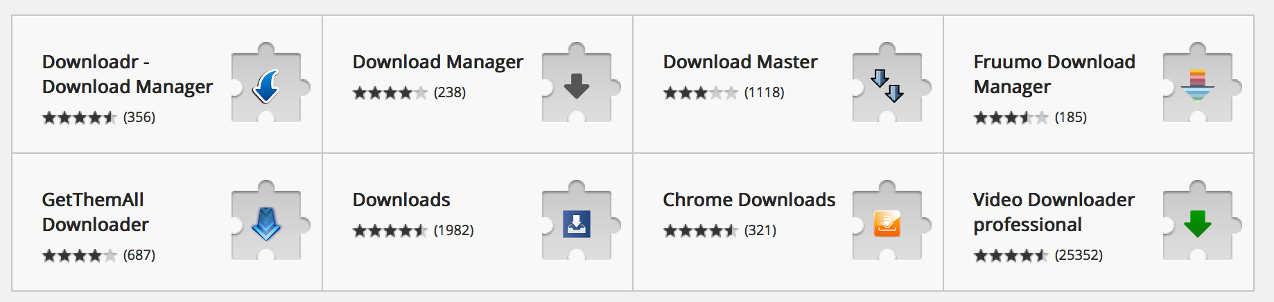

Slide 20
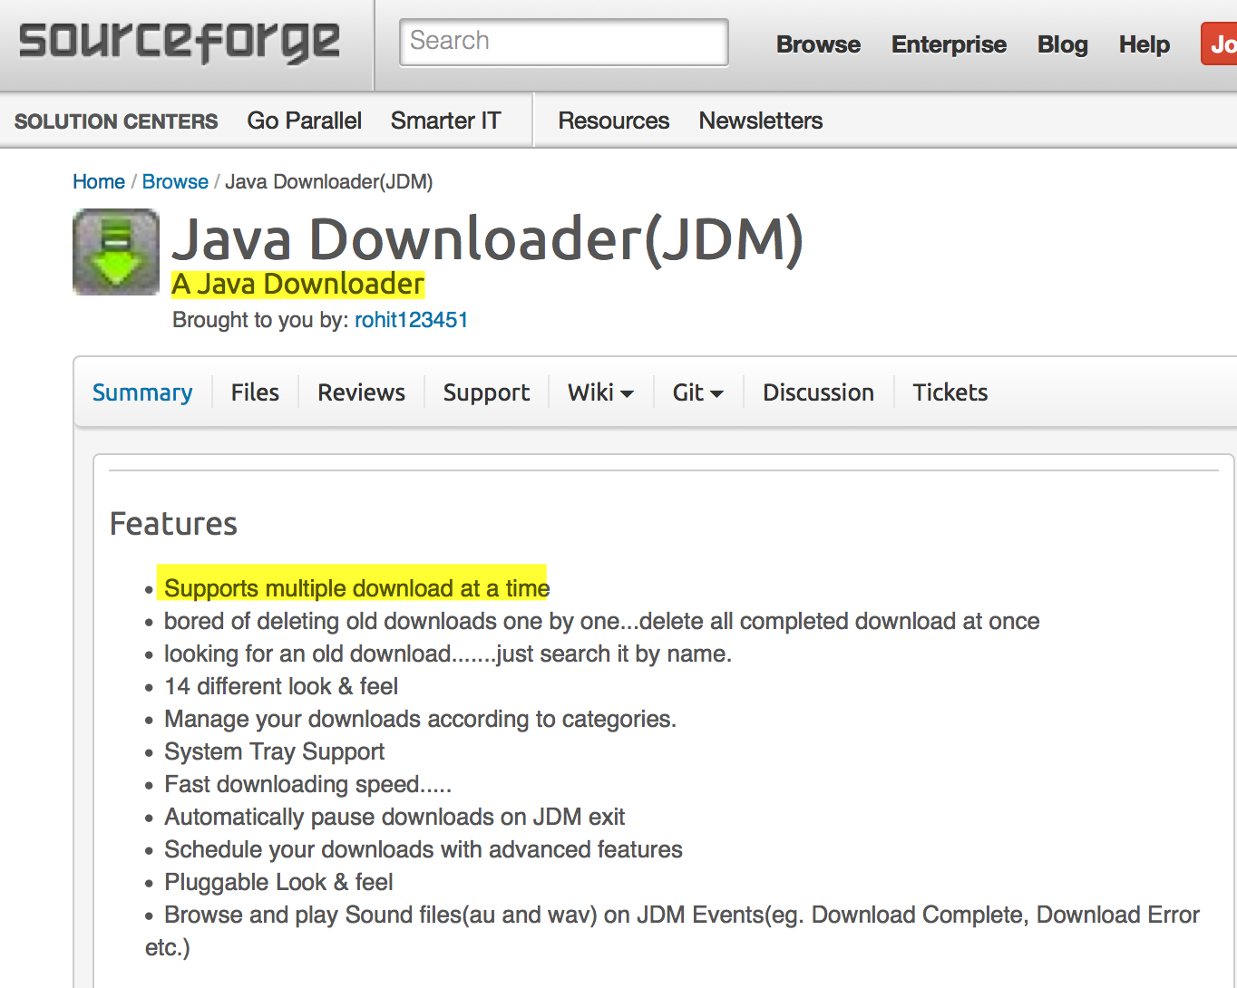
Lucky day: Download manager written in Java!

Slide 21
One does not simply
Embed jdm

Slide 22
Let’s look if we can use it!
No traceable license
No website or docs
No traceable sources
It’s an app, not a lib

Slide 23
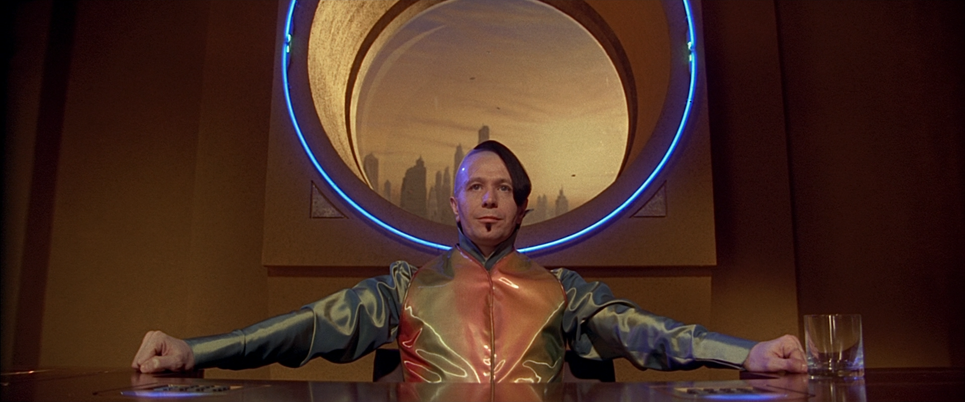
If you want concurrent downloader
Write it yourself

Slide 24

Why won’t you Just
use URLConnection?

Slide 25
Java.net.urlconnection
Memory wasteful (buffering)
Minimal API
Blocking streams

Slide 26


Slide 27
What we’re looking for
Async/non-blocking
Event callbacks

Slide 28
What is IT going to take
Reactor
nio

Slide 29
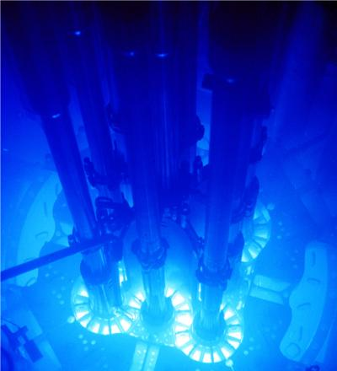
Welcome to the reactor

Slide 30
pattern for lightweight concurrency
Event driven
Threads reuse
Uses non-blocking Io

Slide 31
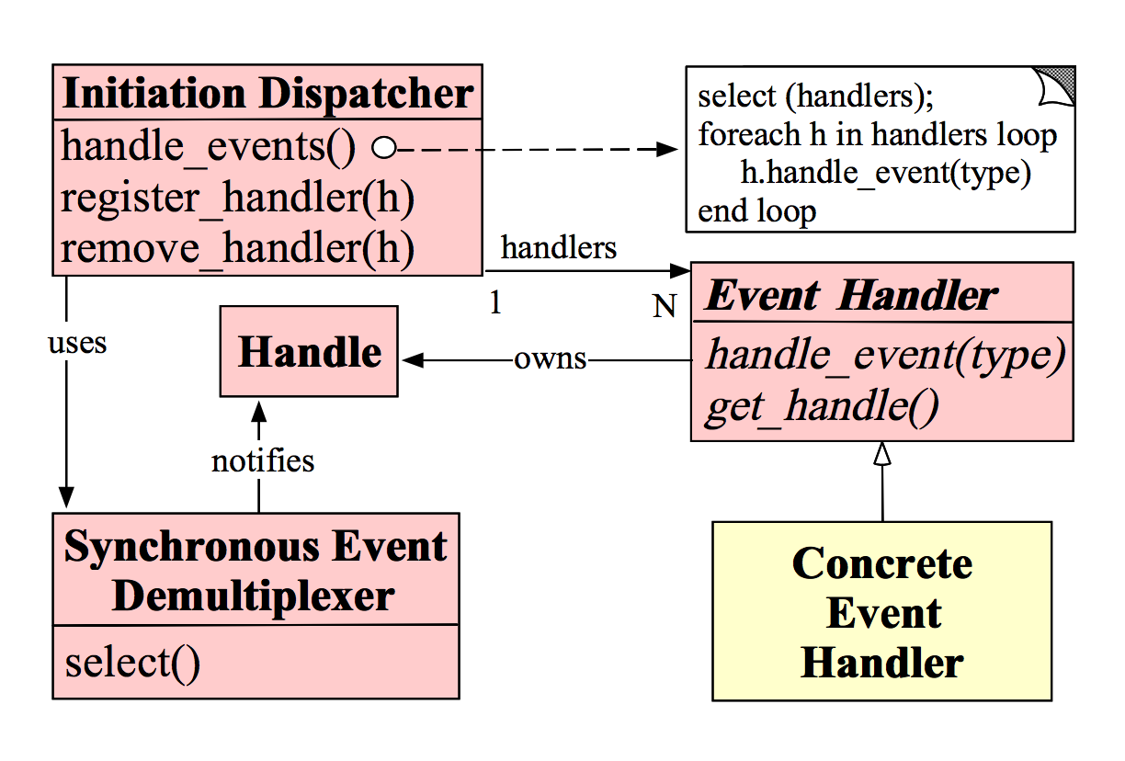
Original pattern
http://www.dre.vanderbilt.edu/~schmidt/PDF/reactor-siemens.pdf
Notes:
Events are multiplexed by a single thread dispatcher

Slide 32
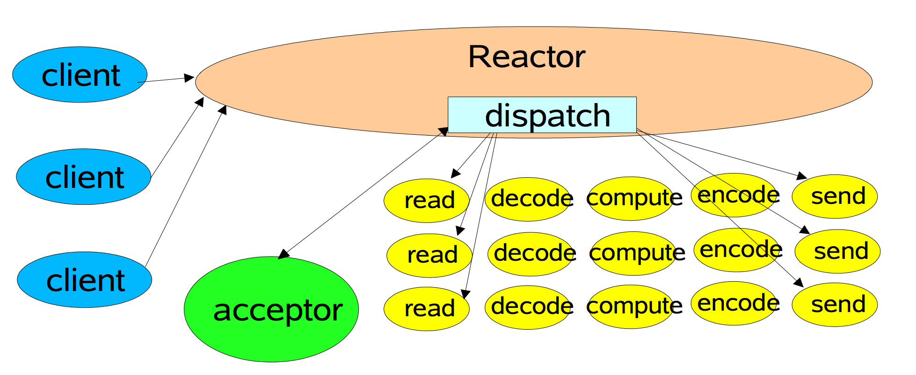
Guess the author by the diagram
http://gee.cs.oswego.edu/dl/cpjslides/nio.pdf

Slide 33

In Java, Reactor means NIO

Slide 34
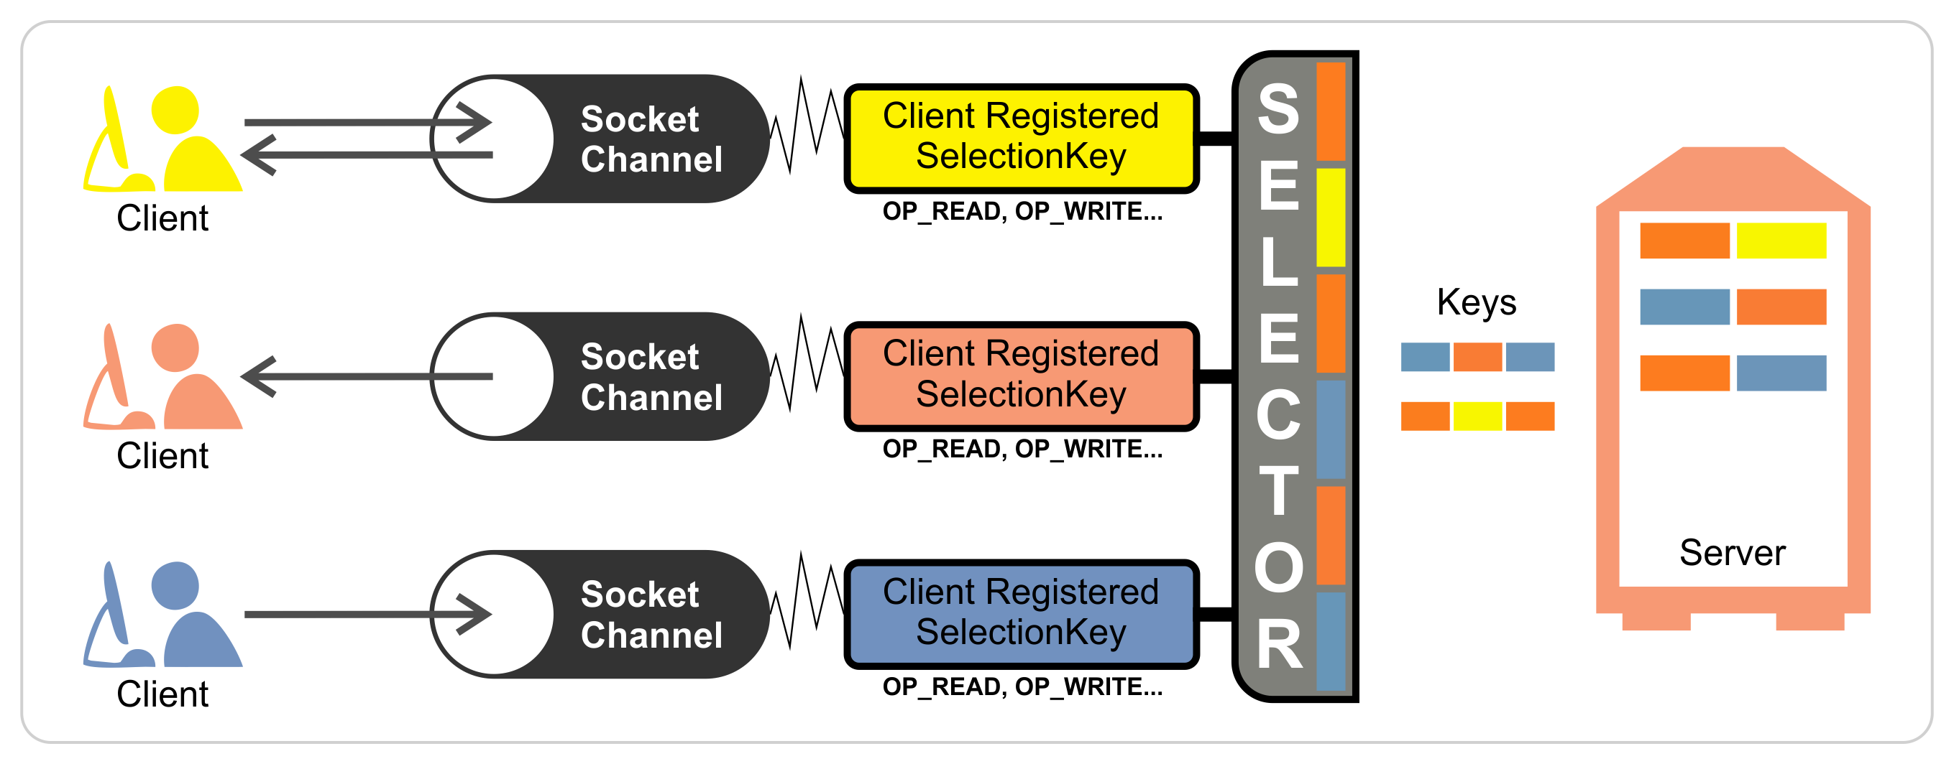
Selector as a multiplexer

Slide 35
Java version - Registering
SocketChannel channel= SocketChannel.open();
socketChannel.connect(new
InetSocketAddress("http://remote.com", 80));
...
Selector selector = Selector.open();
channel.configureBlocking(false);
SelectionKey k = channel.register(selector, SelectionKey.OP_READ);
k.attach(handler);

Slide 36
Java version - Dispatcher
while (!Thread.interrupted()) {
selector.select();
Set selected = selector.selectedKeys();
Iterator it = selected.iterator();
while (it.hasNext())
SelectionKey k = (SelectionKey)(it.next();
((Runnable)(k.attachment())).run();
selected.clear();
}

Slide 37
Handling reactor events is complex
Need to maintain state
Buffering – assembling chunks
Coordinating async events

Slide 38

HTTP NIO Framworks
do the heavy lifting

Slide 39
Nio libraries
Most of them are servers
Netty, grizzly, etc.
Apache Mina
Apache HTTP components asyncclient
Ning http client

Slide 40
Nio libraries
Most of them are servers
Netty, grizzly, etc.
Apache Mina
Apache HTTP components asyncclient
Ning http client

Slide 41

Client and server nio library
Evolved from netty
Latest release October 2012

Slide 42
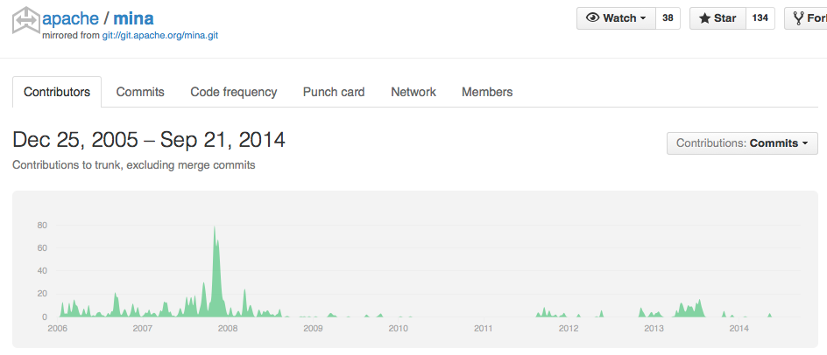

Slide 43
Nio libraries
Most of them are servers
Netty, grizzly, etc
Apache Mina
Apache HTTP components asyncclient
Ning http client

Slide 44


Slide 45
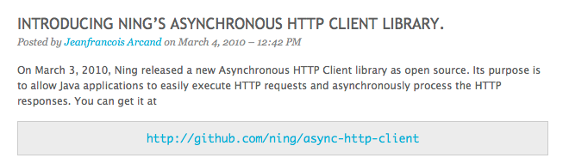
Ning’s async http client

Slide 46
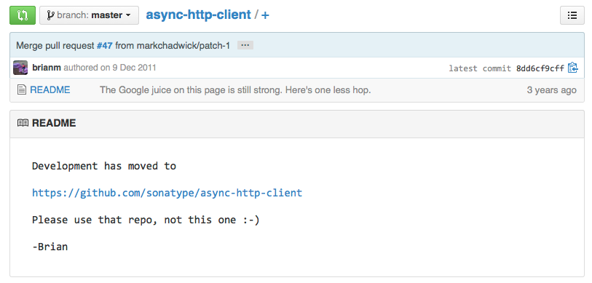

Slide 47
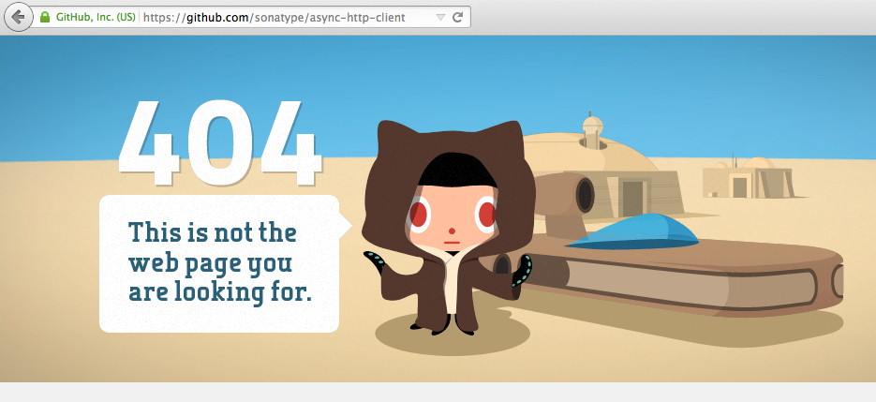

Slide 48
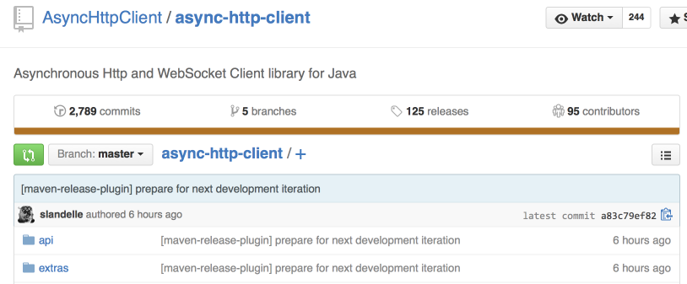
Here it is!

Slide 49

try (AsyncHttpClient asyncHttpClient = new AsyncHttpClient()) { ListenableFuture<Response> future = asyncHttpClient.prepareGet( "http://oss.jfrog.org/api/system/ping").execute( new AsyncCompletionHandler<Response>() { @Override public Response onCompleted(Response response) { System.out.println(response.getResponseBody()); return response; } @Override public void onThrowable(Throwable t) { t.printStackTrace(); } }); Response response = future.get(); }

Slide 50
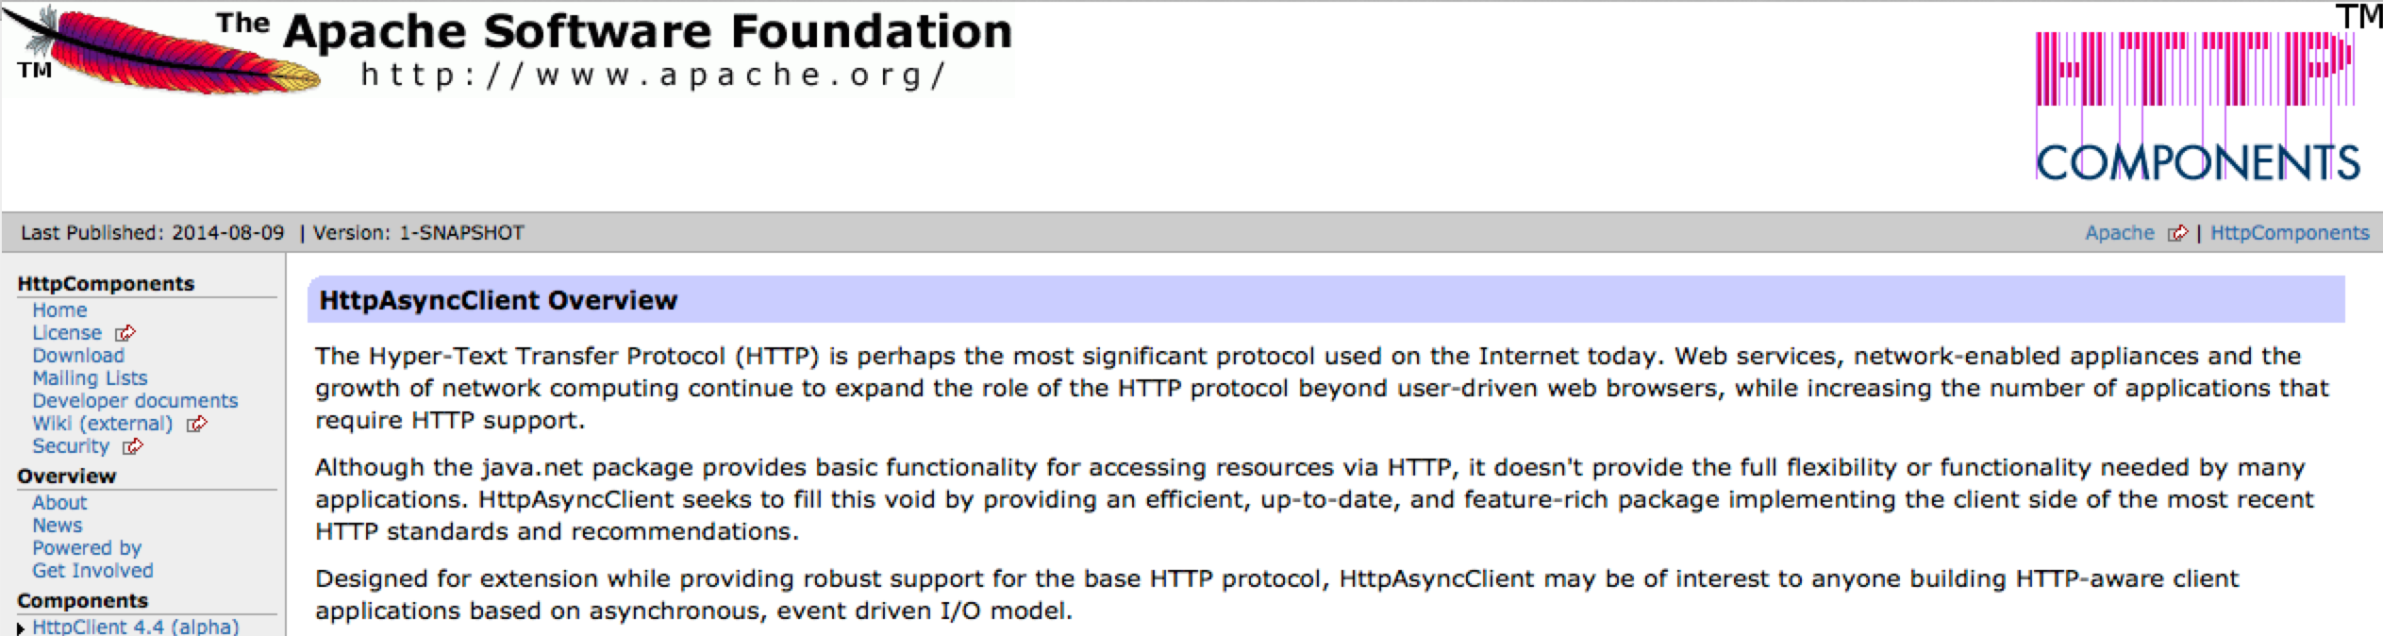

Slide 51
HAC Concepts
Request producer
Response consumer

Slide 53

Wait a second…
They are almost the same!

Slide 54

Choosing between ning and http asyncclient

Slide 55
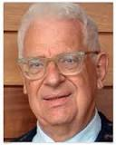
"All problems in computer science can be solved by another level of indirection"
David Wheeler

Slide 56
public interface HttpProviderDownloadHandler { void onResponseReceived(int statusCode, Map<String, List<String>> headers); boolean onBytesReceived(ByteBuffer buf); void onFailed(Throwable error); void onCanceled(); void onCompleted(); }

Slide 57
Head to head
Feature/Library | Ning client | Http Async Client
Maturity | Good | Very new (early 2014)
Download cancelation | Easy | With bugs
Progress hooks | Events not granular enough | Just use onByteReceived()
Documentation | A bit sparse | Minimal
Server-side counterpart | None, client only | org.apache.httpcomponents httpcore-nio
Notes:
TODO send table to back!!!

Slide 58
Performance?
http://blogs.atlassian.com/2013/07/http-client-performance-io/

Slide 59

Rfc2616: a universe of its own
Notes:
Hypertext Transfer Protocol -- HTTP/1.1

Slide 60

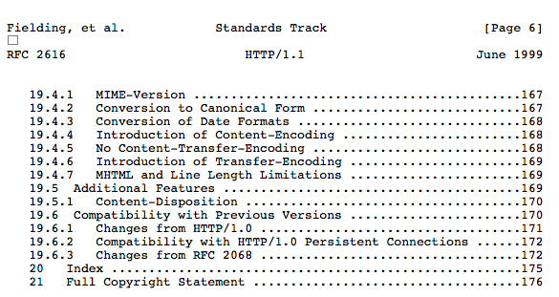

Slide 61

Confused?

Slide 62
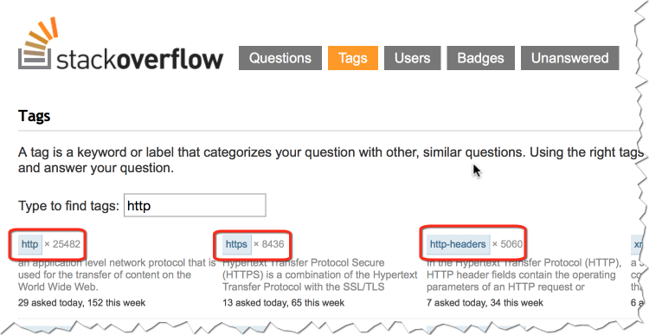
Just read some stackoverflow (and improve your rep as you go)

Slide 63

And that one for discovering that range header is lost on redirect
http War stories

Slide 64

Question!
What should be content-length when using compression?

Slide 65


Slide 66
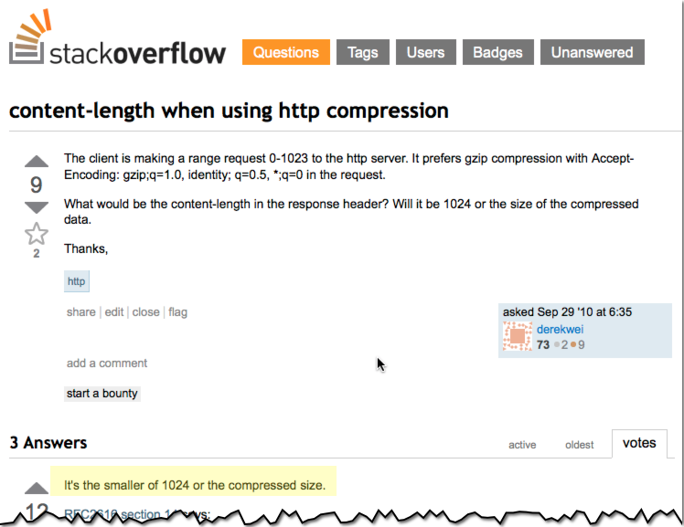


Slide 67
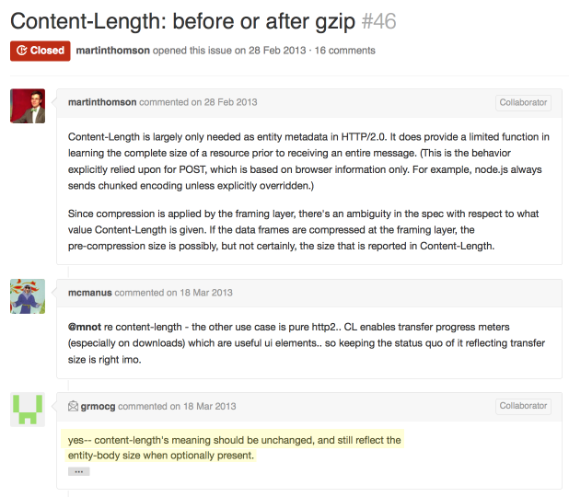
https://github.com/http2/http2-spec/issues/46

Slide 68

Question!
Why when redirected to CDN all the chunks start from zero?

Slide 69
HttpAsyncClientBuilder builder = HttpAsyncClients.custom();
// add redirect strategy that copies "range" headers, if exist
builder.setRedirectStrategy(new DefaultRedirectStrategy() {
@Override
public HttpUriRequest getRedirect(HttpRequest request, HttpResponse response, HttpContext context)
HttpUriRequest redirectRequest = super.getRedirect(request, response, context);
// copy "Range" headers, if exist
Header[] rangeHeaders = request.getHeaders(HttpHeaders.RANGE);
if (rangeHeaders != null) {
for (Header header : rangeHeaders) {
redirectRequest.addHeader(header);
}
}
return redirectRequest;
}});

Slide 70

Question!
How many simultaneous connections should I open?

Slide 71

Http 1.1 goes like:
Can you please limit to 2 connections?
Notes:
RFC2616 8.1.4

Slide 72

Browsers go like:
Notes:
Browsers go like:

Slide 73
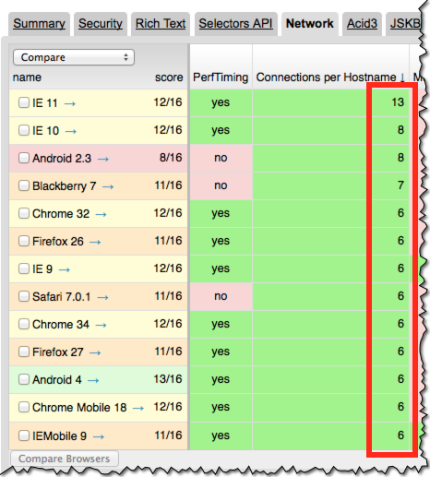

Slide 74

url encoding?

Slide 75
Question!
What’s wrong with the following code?

Slide 76
public static String encodeUrl(String urlStr) { URLEncoder.encode(urlStr, "UTF-8"); ... }

Slide 77
Decoded URLs cannot be re-encoded to the same form
http://example.com/?query=a&b==c
Cannot be decoded back after it was encoded:
http://example.com/?query=a%26b==c

Slide 78
Don’t use java.net.URLEncoder
“Utility class for HTML form encoding. This class contains static methods for converting a String to the application/x-www-form-urlencoded MIME format.
For more information about HTML form encoding, consult the HTML specification.”

Slide 79
AHC Alternatives
org.apache.http.client.utils.URIBuilder
org.apache.http.client.utils.URLEncodedUtils

Slide 80
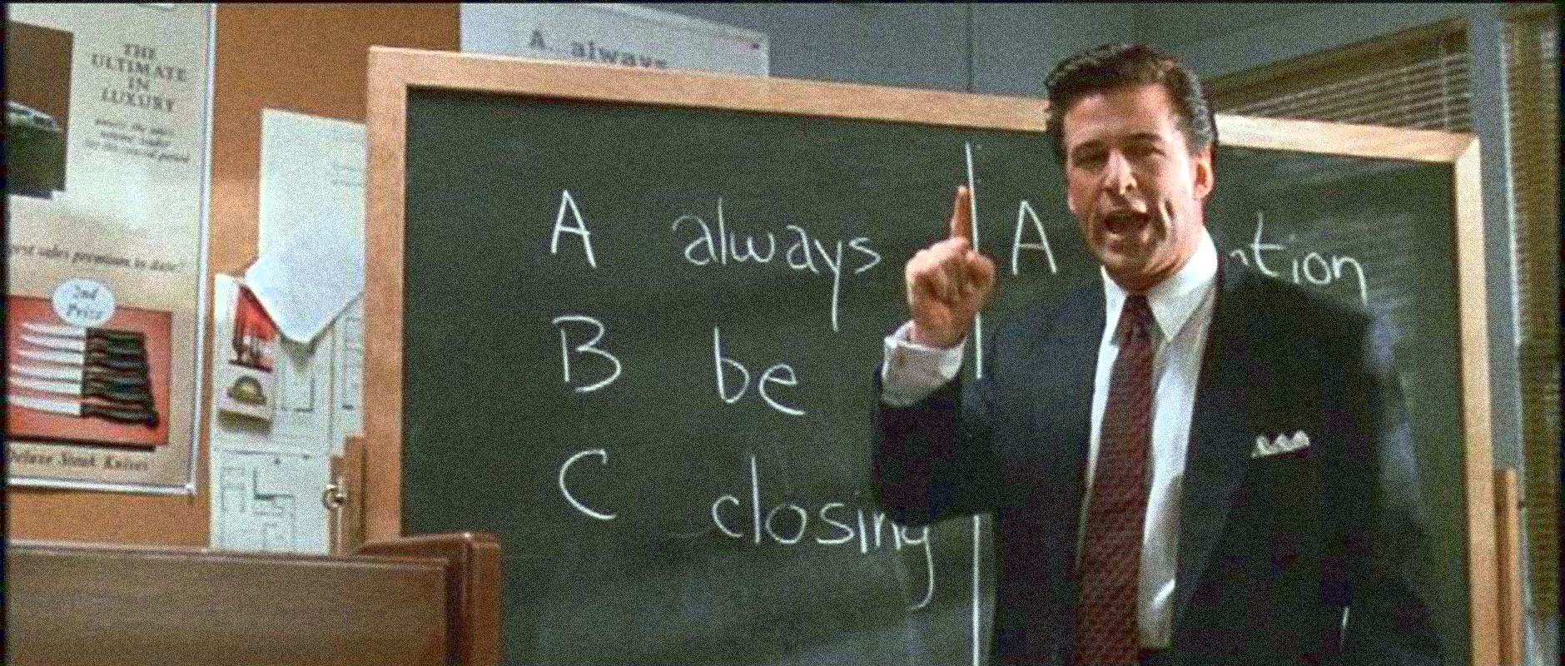

Slide 81

Question!
How do I close a socket correctly?

Slide 82
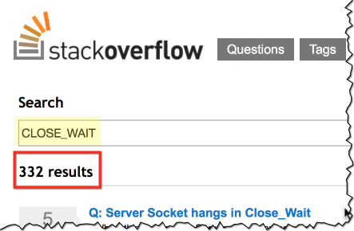
How hard can it be to close a socket?

Slide 83
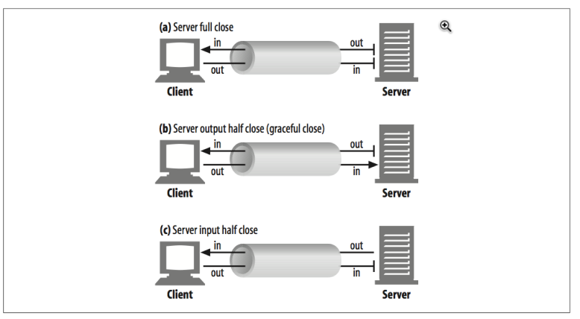
The art of socket closing
http://www.safaribooksonline.com/library/view/http-the-definitive/1565925092/ch04s07.html

Slide 84
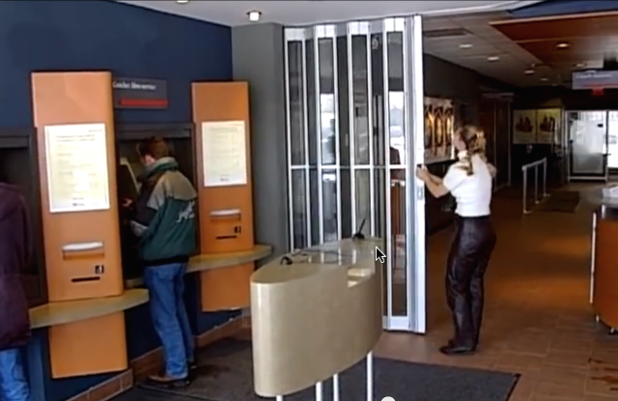
Half-closed: no new customers

Slide 85
Never block in socket close()
The other side expects you to clean up nicely
It will give up on time out
You will wait (forever)

Slide 86

I always close connections
And when I do it, I use try-with-resources

Slide 87
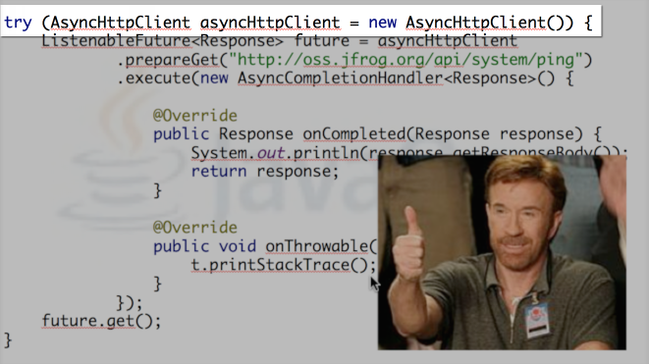
Remember?

Slide 88

Question!
How can I write file parts concurrently?

Slide 89
Write to separate files, combine on finish
Write to same file, seeking to the right position

Slide 90
Why won’t you Just use
Java.io.randomaccessfile?!

Slide 91
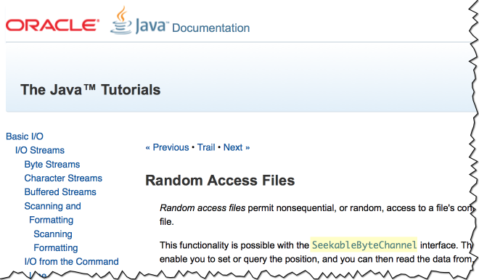
Notes:
RAC is not concurrent!

Slide 92
Use FileChannel
Implements SeekableByteChannel
java.nio.channels.FileChannel#write(
java.nio.ByteBuffer src, long position)

Slide 93
Download progress tracking
FileProgressInfo
FilePartProgressInfo
*
PersistentFileProgressInfo
Save the total size, sha1, number of parts
State of each part (offset, size, completed...)

Slide 94

File Locking

Slide 95
File locking Levels
VM level
OS level

Slide 96
OS level File locking
Multiple downloader instances writing to the same file
Needed for writing:
Partial download file
Persistent download progress

Slide 97
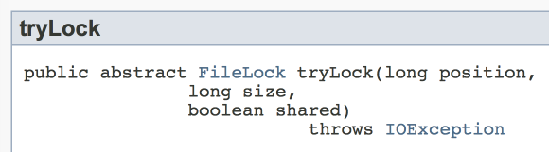
Easy, we need a shared lock!
One writes, the rest read

Slide 98

java.io.IOException "The process cannot access the file because another process has locked a portion of the file"

Slide 99

Windowze…

Slide 100

Solving Windowze with StackOverflow
private FileLock lock(FileChannel fileChannel) throws IOException { FileLock lock = fileChannel.tryLock(Long.MAX_VALUE - 1, 1, false); if (lock == null) { throw new OverlappingFileLockException(); } return lock; }
WAT?!
Notes:
lock beyond the end of file, so we can write while others are reading
avoid OS-dependent no support for shared lock (for concurrent r/w) and fallback to exclusive
+ avoid OS-dependent access effect of exclusive locks (Windoze...)
Allows writing and reading by knowing if someone else is writing
https://community.oracle.com/message/8781694

Slide 101
VM Level File Locking
Why do you need locks
If you write to different parts of file?

Slide 102
VM Level File Locking
Prevent same VM threads writing to the file when we started closing it
Closing sequence:
Release file locks
Close channels
Rename a file to it's final name (remove .part)
Erase progress info

Slide 103
VM Level File Locking
ReentrantReadWriteLock.ReadLock writeToFileLock = rwl.readLock(); ReentrantReadWriteLock.WriteLock closeFileLock = rwl.writeLock();
public void close() throws IOException {
this.closeFileLock.lock();
}
public int write(int partIndex, ByteBuffer buf) { if (!this.writeToFileLock.tryLock()) { throw new IllegalStateException("File is being closed"); } ... }

Slide 104

What’s next?

Slide 105
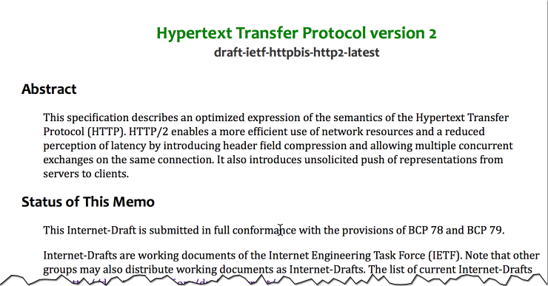
The future is (almost) here!

Slide 106
http/2
Mostly standardizing Google's spdy
Header compression
multiplexing
Prioritization
Server push
On the way clear some stuff
E.g. compressed content length

Slide 107
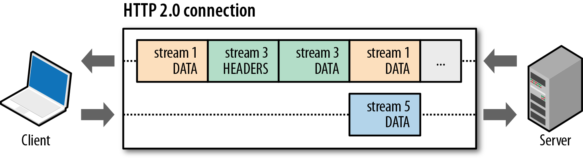
Ease the load

Slide 108
Question!
How many simultaneous connections should I open in HTTP/2?

Slide 109
Links!
RTFM: RFC 2616
Ultimate book: HTTP: The Definitive Guide
Amazon
Safari
Reactor pattern
Doug Lea on NIO
HTTP/2 on GitHub

Slide 110

No, Thank you!

